Slide 1
Find a topic & question

Slide 2
Agenda
Find a topic
Specify the topic
  Idea pyramide
Formulation of a question
  Different types of questions
  Examples for a very bad question

Slide 3
Find a topic
Which topic do you want to address in your term paper?
Why are you interested in this topic?
How do you want to explore this topic?
Notes:
First-year students are asked to think about the topic for 5 minutes; the topic is not final but serves the purpose of working in today’s session.

Slide 4
Concretize the topic
Topic pyramid: Narrow down your topic more and more from top to bottom
Your topics are very individualistic:
There are no "right" steps for the restriction
For example:
Time
Place
Person
Source
Perspective
Author
Notes:
To the students: Once you have chosen a topic, you can restrict it in different ways

Slide 5
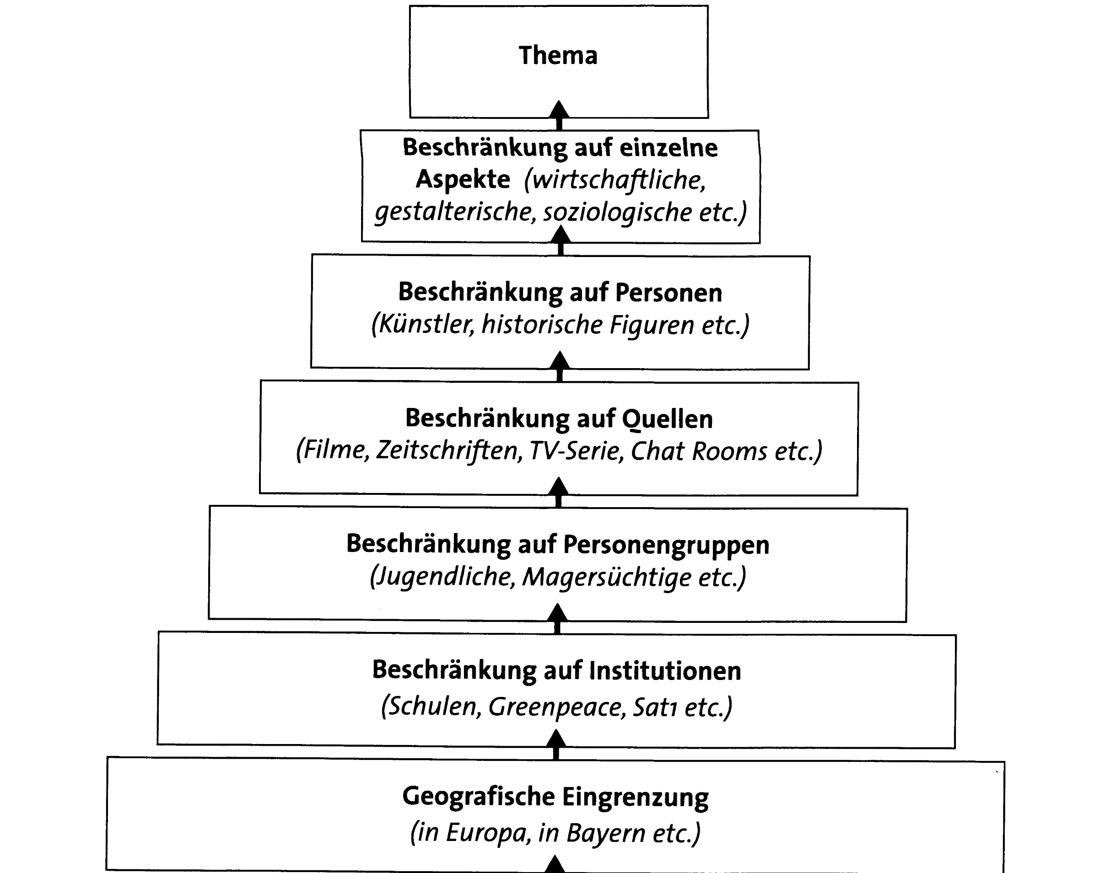
7. Topic
Source
Perspective
Author
6. Restrictions to target
group
Time
Place
Person
5. Local / time
restrictions
4. Restrictions to a perspective
(i.e. significance for…)
3. Restrictions to theory / method/ partial aspects / example
2. Restriction to source / materials
(i.e. in der englishen literature, according to agenda)
Idea
(i.e. sustainability, university history, diver)
Notes:
First-year students have 10 minutes to narrow down their topic through the idea pyramid

Slide 6
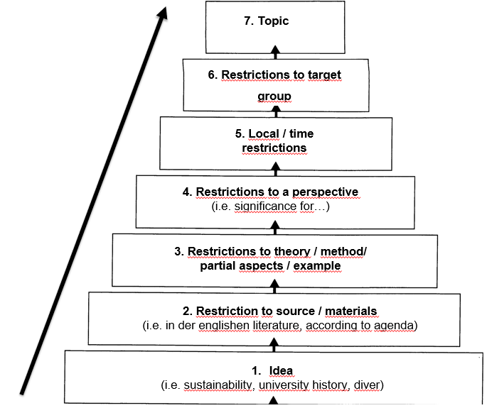
Source
Perspective
Author
Time
Place
Person
How did it work?
Find solutions & ideas for still vague/ open questions.
Notes:
Reflect in plenary

Slide 7
Formulating a research question
“?” = your question should be a question
as precise as possible
Not influenced or biased
Open-ended and without pre-assumptions
The question can still be changed or specified during the work
Scientific work ≠ Listing of facts
Scientific work = problem solving
  The answer is a new scientific contribution
Notes:
How do you get from the topic to the question?
What constitutes a question?

Slide 8
Different types of questions:
Descriptive
  How does the use of fitness content on Instagram affect girls' body image?
Explaining correlations
  How can the accelerated energy transition in Germany in 2021 be explained using the multiple streams approach?
Creative
  What strategy should universities adopt to get environmental science students interested in Python?
Notes:
- By presenting the different types of questions, the first-year students should get an idea of the different approaches they can take on in their term paper.

Slide 9
Different types of questions:
Forecasting
  How will the learning behavior of students change in the next 10 years due to increasing digitalization?
Critically reflecting / evaluating
  How should a quota regulation for the gender ratio on company boards be assessed with regard to the criterion of company performance?
Notes:
https://www.scribbr.de/anfang-abschlussarbeit/forschungsfrage-beispiele/

Slide 10
Formulating a research question
What could by typical for a very bad research question?
Example:
  How has the global economy developed over the last century?
  Does smoking have a negative impact on health?
  How does politics influence society?
Create a list of criteria for a bad research question.
Formulate further examples of a very bad research question!
Notes:
To you: When moderating this page, you could go into more detail about why those questions are not good
Find criteria using those examples
Question: too broad,
Question: yes/no question is often too easy to answer and leaves little room for interpretation, biased
Question: too imprecise, lack of context, unspecifically formulated
The first-year students are then asked to think and, after 5 minutes, collect criteria for a bad question in small groups:
- of clarity, too broad, yes/no questions, lack of relevance, lack of feasibility
Finally, the first-year students can formulate further questions

Slide 11
Are there any open questions?

